Slide 1
Bootcamp
Python for Data Science

Slide 2
Review

Slide 3

Dataframe
Similar to a spreadsheet
Columns are Numpy arrays with special index

Slide 4
creating a Dataframe
new_df = pd.read_csv(“path_to_file”)

Slide 5
Specifying Data Types
pd.read_csv(“path_to_file”,
dtype={“ZIPCODE”: str})

Slide 6
Saving a Dataframe
new_df.to_csv(“path_to_file”)

Slide 7
Looking at top rows
new_df.head()

Slide 8
Using Numpy functions
new_df[‘score’].mean()

Slide 9
Creating a new Column
df[‘profit’] =
df[‘revenue’] - df[‘expenses’]

Slide 10
Dataframe from columns
df[[‘revenue’, ‘profit’]]

Slide 11
Sorting
df.sort_values(“revenue”,
ascending=False)

Slide 12
Importing from and exporting to excel

Slide 13
Dataframe from Excel
pd.read_excel(“path_to_file”,
sheet_name=None)
{“sheet1”: dataframe1,
“sheet2”: dataframe2}

Slide 14
Dataframe from Excel
pd.read_excel(“path_to_file”,
sheet_name=“bla”)

Slide 15
Saving a Dataframe
new_df.to_excel(“path_to_file”)

Slide 16
Exercises

Slide 17
Grouping

Slide 18
Counting Unique values
df[‘first_name’].value_counts()

Slide 19
Counting Unique values
df[‘first_name’].value_counts()
“John”: 352
“Chris”: 280
“Tom”: 264

Slide 21
Group By
Generalized .value_counts()
Combines rows using a ufunc

Slide 23
GRoupBY
df.groupby(“first_name”)
A GroupBy object

Slide 24
GRoupBY
df.groupby(“first_name”).sum()
How other columns are combined

Slide 25
Exercises

Slide 26
Pivot Tables

Slide 27
Pivot table
Similar to groupby
Segments data along multiple axes

Slide 29
Pivot table syntax
sales_df.pivot_table(
values=[“quantity”,”price”],
index=“name”
)
takes AVG by default

Slide 31
Pivot table syntax
sales_df.pivot_table(
values=[“quantity”,”price”],
index=“name”,
aggfunc=“sum”
)

Slide 32
Beyond Groupby

Slide 33
Columns
Columns segment values, just like index
Will form bins from unique values in column you specify

Slide 34
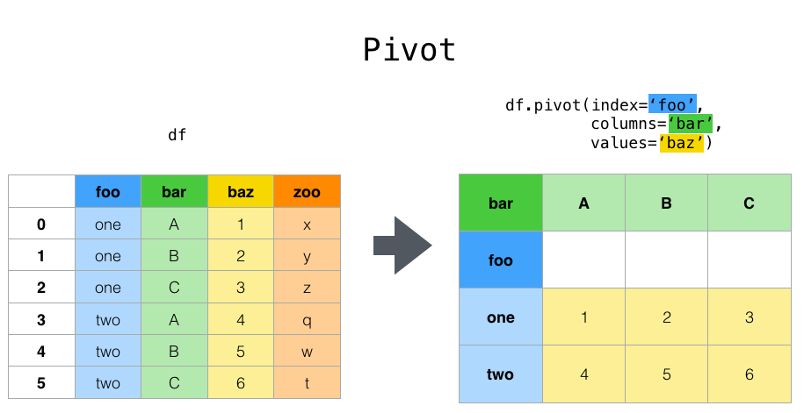

Slide 35
Pivot table syntax
sales_df.pivot_table(
values=[“quantity”,”price”],
index=“name”,
columns=“ABC”)

Slide 36
Exercises

